Slide 1
KHATRA ADIBASI MAHAVIDYALAYA
B.A Program in Physical Education Name of the Teacher- TITHI ROY
Subject- Physical Education
Semester - III
Course Title: Yogasana and Gymnastics
Topic: Unit- I: YOGASANA
Session: 2021-22

Slide 2
YOGA

Slide 7
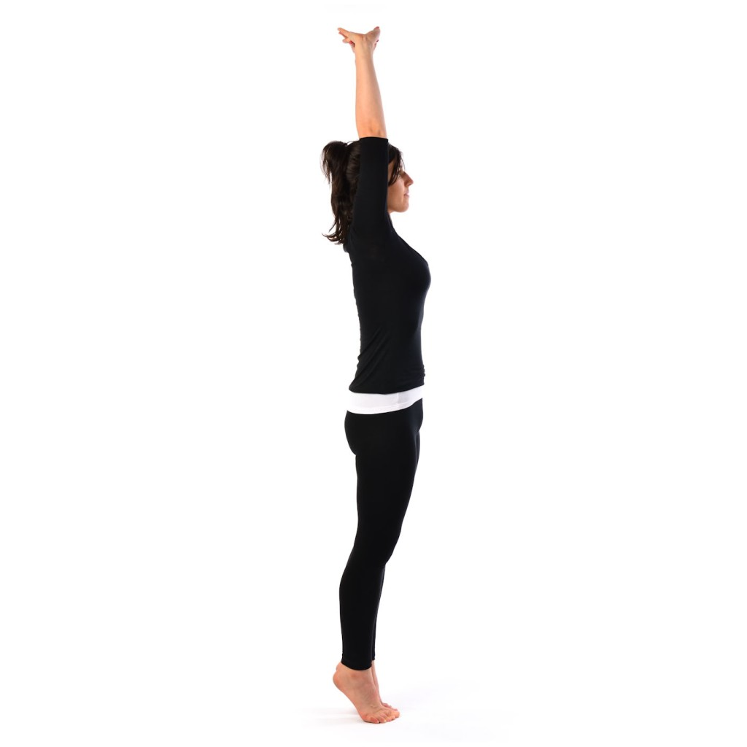

Slide 10
Baddha Konasana

Slide 12
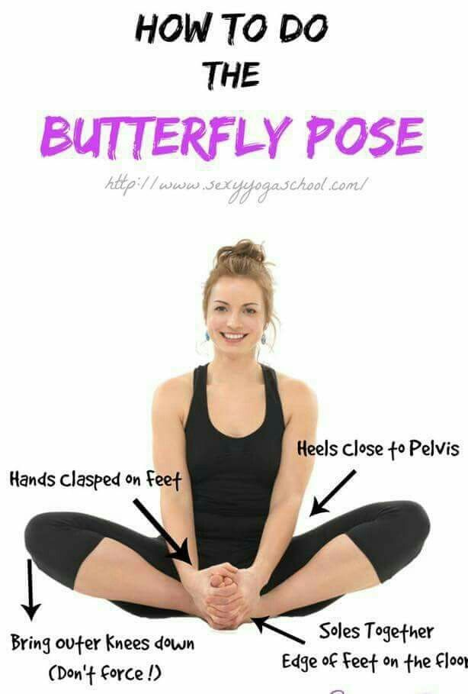

Slide 13
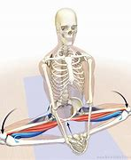

Slide 14
Baddha Konasana

Slide 15
THANKS TO ALL

